Slide 1
CHAPTER 3
The Structure of Crystalline Solids
Chapter Outline
Unit cells
Crystal structures
  Face-centered cubic
  Body-centered cubic
  Hexagonal close-packed
Close packed crystal structures
Density
Types of solids
  Single crystal
  Polycrystalline
  Amorphous

Slide 2
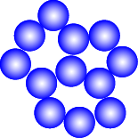
Energy and Packing
• Non dense, random packing
Energy
typical neighbor
bond length
typical neighbor
r
bond energy
• Dense, ordered packing
Energy
typical neighbor
bond length
typical neighbor
r
bond energy
Dense, ordered packed structures tend to have
lower energies.

Slide 3
Materials and Packing
Crystalline materials...
• atoms pack in periodic, 3D arrays
• typical of:
-metals
-many ceramics
-some polymers
crystalline SiO2
Si
Oxygen
Noncrystalline materials...
• atoms have no periodic packing
• occurs for:
-complex structures
-rapid cooling
"Amorphous" = Noncrystalline
noncrystalline SiO2

Slide 4
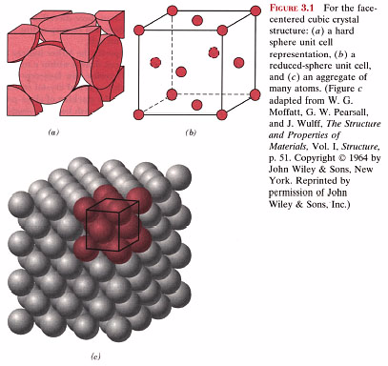
Crystal structure
Consider atoms as hard spheres with a radius.
Shortest distance between two atoms is a diameter.
Crystal described by a lattice of points at center of atoms

Slide 5
Unit Cell
The unit cell is building block for crystal.
Repetition of unit cell generates entire crystal.
crystalline structure

Slide 6
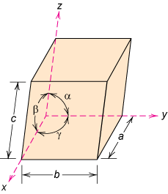
Unit cell: smallest repetitive volume which contains the complete lattice pattern of a crystal.
7 crystal systems
14 crystal lattices
a, b, and c are the lattice constants

Slide 7
Metallic Crystal Structures
Metals usually polycrystalline
amorphous metal possible by rapid cooling
Bonding in metals non-directional ⇒
large number of nearest neighbors and dense atomic packing
Atom (hard sphere) radius, R:
defined by ion core radius: ~0.1 - 0.2 nm
-Nearest neighbor distances tend to be small in
order to lower bond energy.
Most common unit cells
Faced-centered cubic (FCC)
Body-centered cubic (BCC)
Hexagonal close-packed (HCP).

Slide 8
Face-Centered Cubic (FCC) Crystal Structure
Atoms located at corners and on centers of faces
Cu, Al, Ag, Au have this crystal structure
Two representations of the FCC unit cell

Slide 9
Face-Centered Cubic Crystal Structure
R
a
Hard spheres touch along diagonal
⇒ the cube edge length, a= 2R√2
The coordination number, CN = number of closest neighbors = number of touching atoms, CN = 12
Number of atoms per unit cell, n = 4.
FCC unit cell:
  6 face atoms shared by two cells: 6 x 1/2 = 3
  8 corner atoms shared by eight cells: 8 x 1/8 = 1
Atomic packing factor, APF
= fraction of volume occupied by hard spheres
= (Sum of atomic volumes)/(Volume of cell)
= 0.74 (maximum possible)

Slide 10
Atomic Packing Fraction
APF= Volume of Atoms/ Volume of Cell
Volume of Atoms = n (4π/3) R³
Volume of Cell = a³

Slide 11
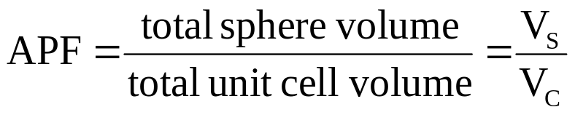

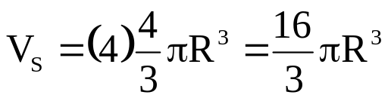

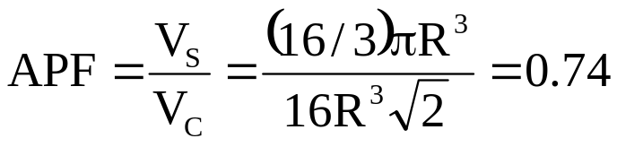
Example Problem
Show that the atomic packing factor for the FCC crystal structure is 0.74
Solution
The APF is defined as the fraction of solid sphere volume in a unit cell, or
Both the total sphere and unit cell volumes may be calculated in terms of
the atomic radius R. The volume for a sphere is , and since there
are four atoms per FCC unit cell, the total FCC sphere volume is
The total unit cell volume is
Therefore, the atomic packing factor is

Slide 12
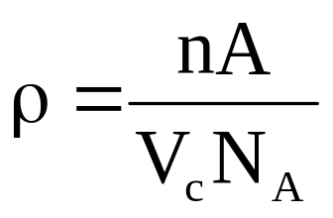
Density Computations
ρ = mass/volume
= (atoms in the unit cell, n ) x (mass of an atom, M) /(the volume of the cell, V_{c})
Atoms in the unit cell, n = 4 (FCC)
Mass of an atom, M = A/N_{A}
A = Atomic weight (amu or g/mol)
Avogadro number N_{A} = 6.023 × 10²³ atoms/mol
The volume of the cell, V_{c} = a³ (FCC)
a = 2R√2 (FCC)
R = atomic radius

Slide 13
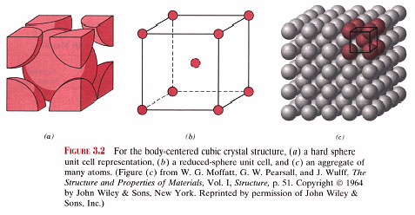
Body-Centered Cubic Crystal Structure
a
Hard spheres touch along cube diagonal ⇒
cube edge length, a= 4R/√3
The coordination number, CN = 8
Number of atoms per unit cell, n = 2
  Center atom not shared: 1 x 1 = 1
  8 corner atoms shared by eight cells: 8 x 1/8 = 1
Atomic packing factor, APF = 0.68
Corner and center atoms are equivalent

Slide 14
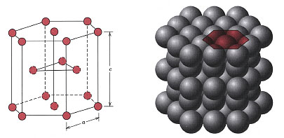
Hexagonal Close-Packed Crystal Structure
Six atoms form regular hexagon surrounding one atom in center
Another plane is situated halfway up unit cell
(c-axis) with 3 additional atoms situated at interstices of hexagonal (close-packed) planes
Cd, Mg, Zn, Ti have this crystal structure

Slide 15
Hexagonal Close-Packed Crystal Structure
Unit cell has two lattice parameters a and c.
Ideal ratio c/a = 1.633
The coordination number, CN = 12 (same as in FCC)
Number of atoms per unit cell, n = 6.
3 mid-plane atoms not shared: 3 x 1 = 3
12 hexagonal corner atoms shared by 6 cells:
12 x 1/6 = 2
2 top/bottom plane center atoms shared by 2 cells:
2 x 1/2 = 1
Atomic packing factor, APF = 0.74 (same as in FCC)

Slide 16
Atoms in unit cell, n = 2 (BCC); 4 (FCC); 6 (HCP)
Mass of atom, M = Atomic weight, A, in amu (or g/mol). Translate mass from amu to grams divide atomic weight in amu by Avogadro number
N_{A} = 6.023 × 10²³ atoms/mol
Volume of the cell, V_{c} = a³ (FCC and BCC)
a = 2R√2 (FCC); a = 4R/√3 (BCC)
where R is the atomic radius

Slide 17
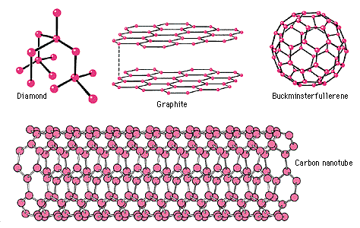
Polymorphism and Allotropy
Some materials can exist in more than one crystal structure, Called polymorphism.
If material is an elemental solid: called allotropy.
Ex: of allotropy is carbon:
can exist as diamond, graphite, amorphous carbon.

Slide 18

Point Coordinates
z
111
c
Point coordinates for unit cell center are
a/2, b/2, c/2 ½ ½ ½
Point coordinates for unit cell corner are 111
Translation: integer multiple of lattice constants → identical position in another unit cell
y
a
000
b
x
z
2c
b
y
b

Slide 19
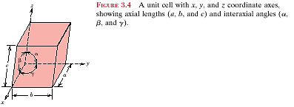

Slide 20
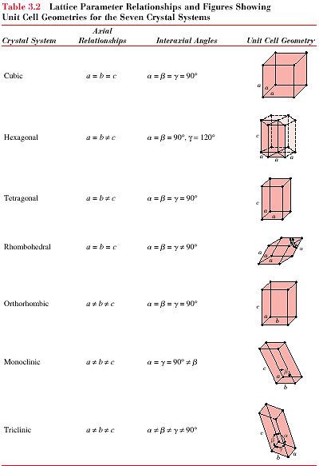
6 lattice parameters
立方
六方
正方
斜方六面
斜方晶系
單斜
三斜

Slide 21
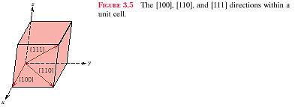
Miller indices
[direction]
( plane )

Slide 22
Example Problem
Determine the indices for the direction shown in the accompanying figure.
z
Projection on
x axis (a/2)
Projection on
y axis (b)
c
y
x
This procedure may be summarized as follows:
x y z
Projections a/2 b 0c
Projections (in terms of a, b, and c) 1/2 1 0
Reduction 1 2 0
Enclosure [120]

Slide 23
晶體平面：(hkl)
Miller氏命名法：晶面如與各晶軸之交點交於比例為1/h、1/k、1/l單位向量處，則該面稱為(hkl)面 ; 此處假設h、k、l無公約數。

Slide 24
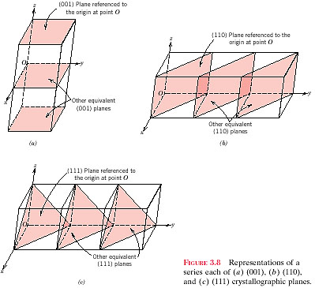
( h , k , l )  { h , k , l }
[ h ,k , l ]  < h ,k , l >

Slide 25
Crystallographic Planes
z
example
a b c
c
1. Intercepts
1 1 ∞
2. Reciprocals
1/1 1/1 1/∞
1 1 0
3. Reduction
1 1 0
y
a
b
4. Miller Indices (110)
x
z
example
a b c
1. Intercepts
1/2 ∞ ∞
c
2. Reciprocals
1/½ 1/∞ 1/∞
2 0 0
3. Reduction
2 0 0
y
4. Miller Indices (100)
a
b
x

Slide 26
Family of Planes {hkl}
Ex: {100} = (100),
(010),
(001),
(100),
(010),
(001)

Slide 27
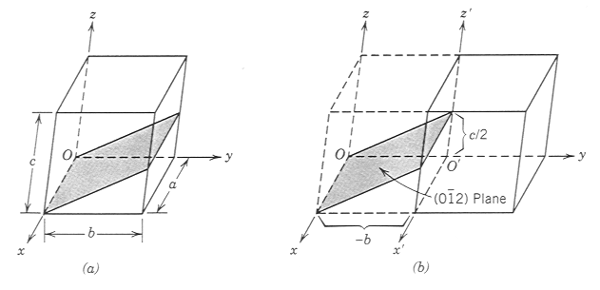
Example Problem
Determine the Miller indices for the plane shown in the accompanying
sketch (a)
x’ y’ z’
∞ -1 1/2
0 1 2
x’’ y’’ z’’
∞ -2 1
0 -1/2 1
0 1 2

Slide 28
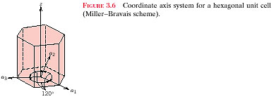
HEXAGONAL CRYSTALS
A problem arises for crystals having hexagonal symmetry in that some crystallo-
graphic equivalent directions will not have the same set of indices. This is circum-
vented by utilizing a four-axis, or Miller-Bravais, coordinate system as shown in
Figure 3.6. The three a₁ , a₂ , and a₃ axes are all contained within a single plane
(called the basal plane), and at 120º angles to one another.

Slide 29
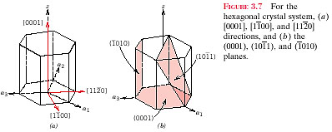

Slide 30
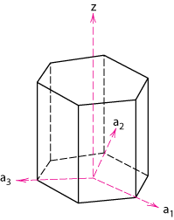
example
a₁ a₂ a₃ c
1. Intercepts
1 ∞
-1
1
z
2. Reciprocals
1 1/∞
-1
1
1 0
-1
1
3. Reduction
1 0
-1
1
4. Miller-Bravais Indices
(1011)
a₂
a₃
a₁

Slide 31
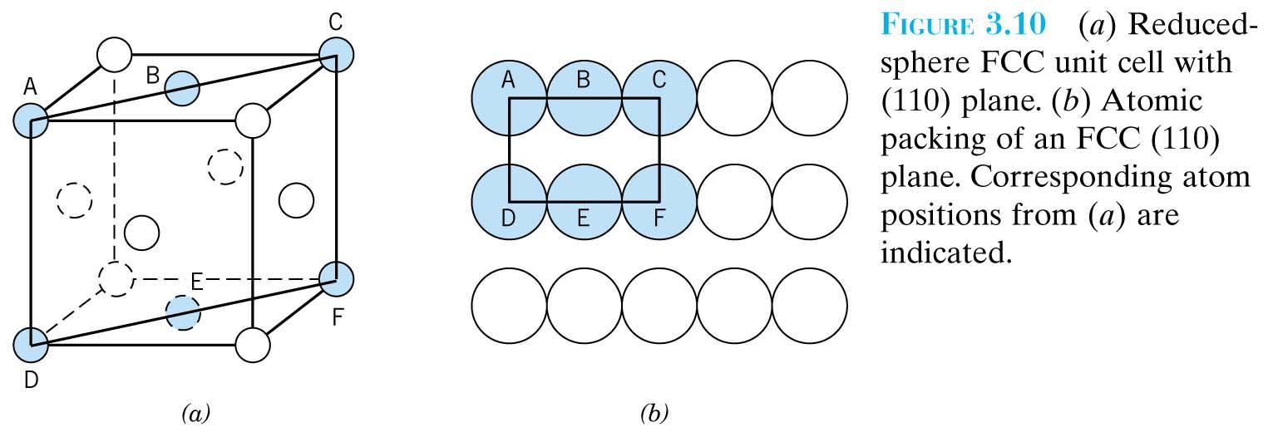
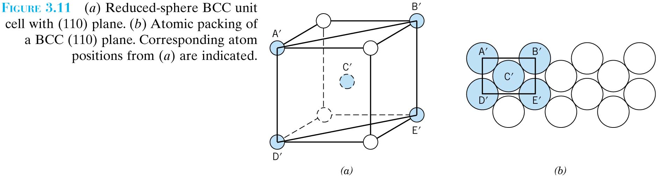

Slide 32
Linear density (LD)
number of atoms centered on direction vector
LD= -------------------------------------------------------------------
length of direction vector
Planar density (PD)
number of atoms centered on a plane
PD= ---------------------------------------------------------
area of plane

Slide 33
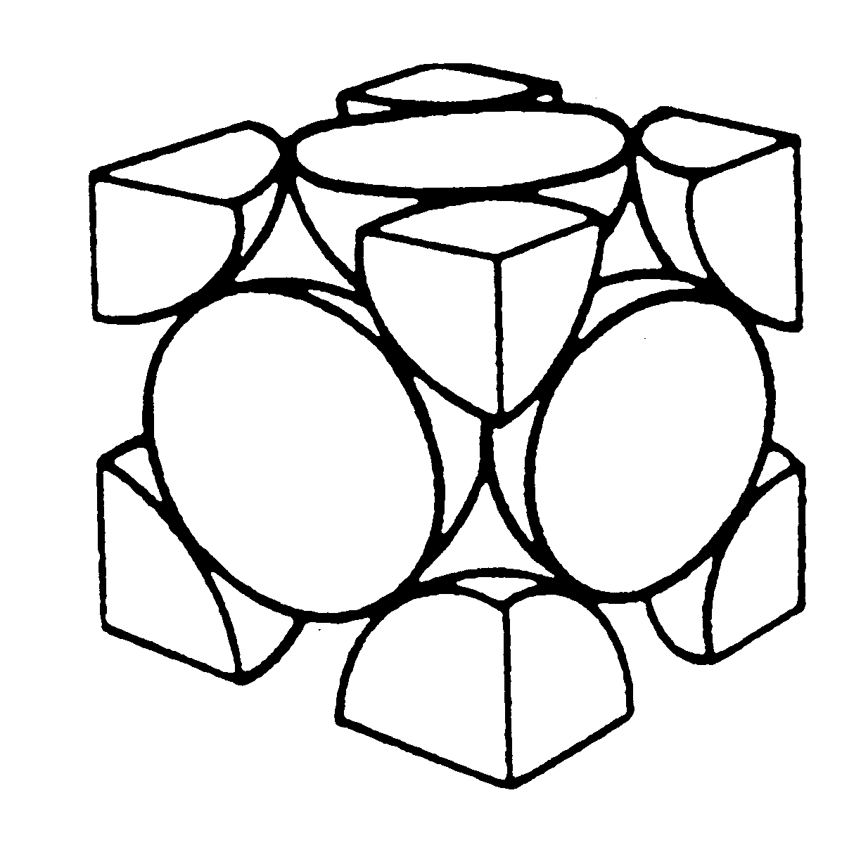
Linear Density
Linear Density of Atoms ≡ LD =
Number of atoms
Unit length of direction vector
[110]
ex: linear density of Al in [110]
direction
a = 0.405 nm
# atoms
a
2
LD
=
=
3.5 nm
-
1
2
a
length

Slide 34
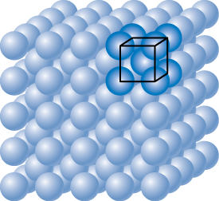
Planar Density of (100) Iron
Solution: At T < 912°C iron has the BCC structure.
2D repeat unit
(100)
4
3
a
=
R
3
Radius of iron R = 0.1241 nm
atoms
2D repeat unit
1
1
atoms
atoms
Planar Density =
=
2
=
12.1
= 1.2 x 10¹⁹
a
2
4
3
nm²
m²
area
R
2D repeat unit
3

Slide 35
Planar Density of (111) Iron
Solution (cont): (111) plane
1 atom in plane/ unit surface cell
2
a
atoms in plane
atoms above plane
atoms below plane
2D repeat unit
3
h
=
a
2
⎛
4
3
⎞
2
16
3
area
=
2
ah
=
3
a
2
=
3
⎜
R
⎜
=
R
2
⎜
3
3
atoms
⎝
⎠
2D repeat unit
1
Planar Density =
atoms
=
atoms
=
7.0
0.70 x 10¹⁹
area
16
3
nm²
m²
R
2
2D repeat unit
3

Slide 36
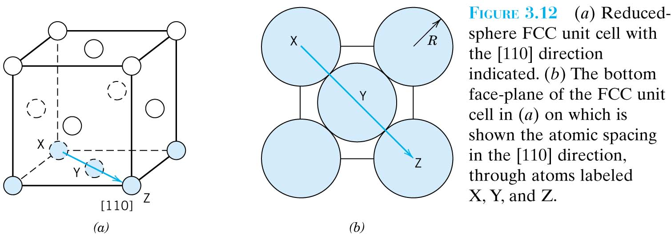

Slide 37
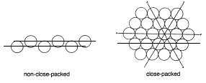
Close-Packed
· Close-packed：相鄰之原子緊密相接
· Close-packed之程度，對材料的機械性質影響很大
對韌性、伸長率之作用尤其重要。

Slide 38
Corner and face atoms in unit cell are equivalent
FCC has APF of 0.74
  Maximum packing ⇒ FCC is close-packed structure
FCC can be represented by a stack of close-packed planes (planes with highest density of atoms)

Slide 39
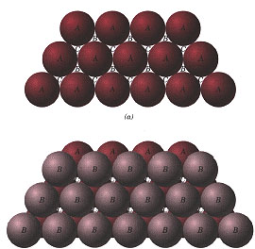
Close-packed Structures (FCC and HCP)
FCC and HCP: APF =0.74 (maximum possible value)
FCC and HCP may be generated by the stacking of close-packed planes
Difference is in the stacking sequence
HCP: ABABAB...
FCC: ABCABCABC…

Slide 40
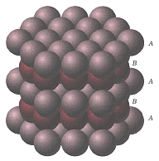
HCP: Stacking Sequence ABABAB...
Third plane placed directly above first plane of atoms

Slide 41
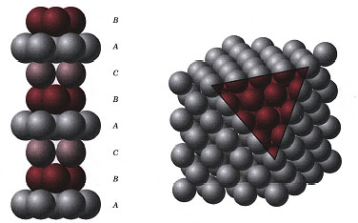
FCC: Stacking Sequence ABCABCABC...
Third plane placed above “holes” of first plane not covered by second plane

Slide 42
FCC Stacking Sequence
• ABCABC... Stacking Sequence
• 2D Projection
B
B
B
B
C
C
C
A
A
A
B
B
B
B
B
A sites
B
B
C
C
C
C
C
C
B
sites
B
sites
B
B
B
B
C
sites
A
• FCC Unit Cell
B
C

Slide 43
Hexagonal Close-Packed Structure (HCP)
• ABAB... Stacking Sequence
• 3D Projection
• 2D Projection
A sites
Top
layer
c
B
sites
Middle layer
A sites
Bottom layer
a

Slide 44
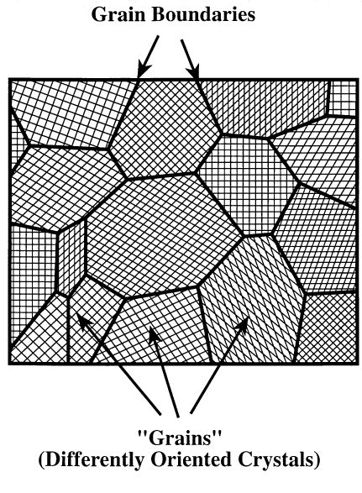
Single Crystals and Polycrystalline Materials
Single crystal: periodic array over entire material
Polycrystalline material: many small crystals (grains) with varying orientations.
Atomic mismatch where grains meet (grain boundaries)
Grain Boundary

Slide 45
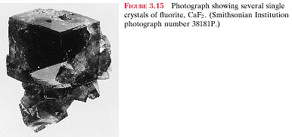

Slide 46
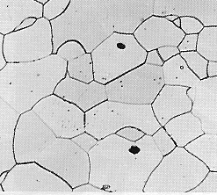
Single vs Polycrystals
• Single Crystals
E (diagonal) = 273 GPa
-Properties vary with
direction: anisotropic.
-Example: the modulus
of elasticity (E) in BCC iron:
E (edge) = 125 GPa
• Polycrystals
-Properties may/may not
vary with direction.
-If grains are randomly
oriented: isotropic.
(E_{poly iron} = 210 GPa)
-If grains are textured,
anisotropic.
200 mm

Slide 47
Anisotropy
Different directions in a crystal have different packing.
For instance: atoms along the edge of FCC unit cell are more separated than along the face diagonal.
Causes anisotropy in crystal properties
Deformation depends on direction of applied stress
If grain orientations are random → bulk properties are isotropic
Some polycrystalline materials have grains with preferred orientations (texture): material exhibits anisotropic properties

Slide 48
Polymorphism
Two or more distinct crystal structures for the same material (allotropy/polymorphism)
titanium
α, β-Ti
  carbon
diamond, graphite
iron system
liquid
1538ºC
BCC
δ-Fe
1394ºC
FCC
γ-Fe
912ºC
BCC
α-Fe

Slide 49
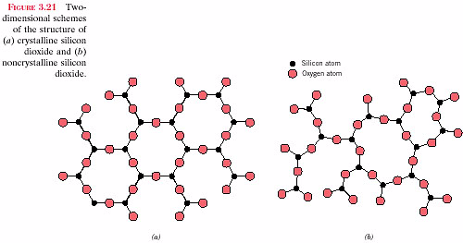
Non-Crystalline (Amorphous) Solids
Amorphous solids: no long-range order
Nearly random orientations of atoms
(Random orientation of nano-crystals can be
amorphous or polycrystalline)
Schematic Diagram of Amorphous SiO₂
non-crystalline solid ( amorphous )
•structure is random , up to 10 Å scale in order

Slide 50


Slide 51
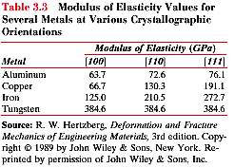
anisotropic
isotropic

Slide 52
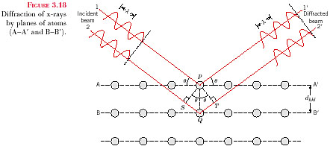
X-Ray Diffraction
Bragg’s law
nλ = 2d_{hkl} · sinθ
λ ≈ 1.5402 Å
[Cu Kα]

Slide 53
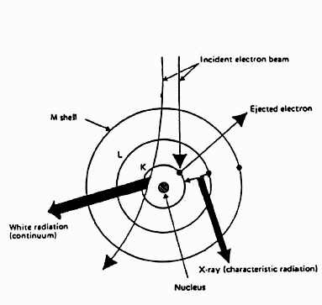
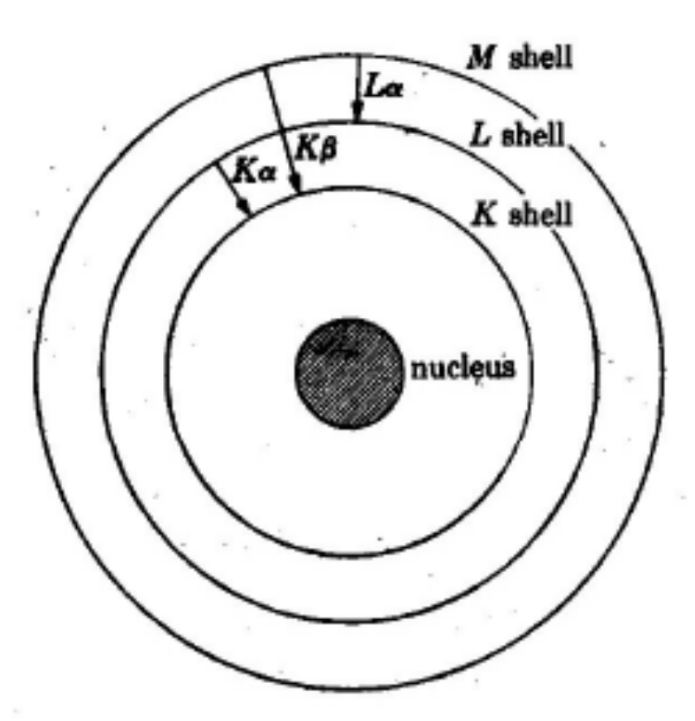
X-ray 的產生

Slide 54
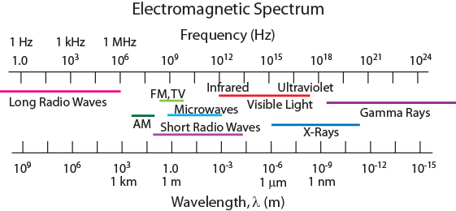
X-Ray Diffraction
Diffraction gratings must have spacings comparable to the wavelength of diffracted radiation.
Can’t resolve spacings < λ
Spacing is the distance between parallel planes of atoms.

Slide 55
X-Rays to Determine Crystal Structure
• Incoming X-rays diffract from crystal planes.
“1”
detector
incoming
reflections must
X-rays
“2”
“1”
be in phase for
outgoing X-rays
a detectable signal
extra
“2”
λ
distance
θ
θ
travelled
by wave “2”
spacing
d
between
planes
Measurement of critical angle, θ_{c}, allows computation of planar spacing, d.
X-ray
intensity
n λ
d =
(from
2 sin
θ
c
detector)
θ
θ
c

Slide 56
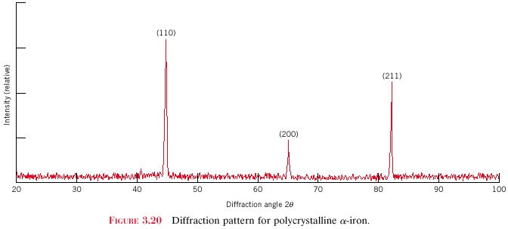
X-Ray Diffraction Pattern
z
z
z
c
c
c
y
(110)
y
y
a
b
a
b
a
b
x
x
x
(211)
Intensity (relative)
(200)
Diffraction angle 2θ
Diffraction pattern for polycrystalline α-iron (BCC)

Slide 57
SUMMARY
• Atoms may assemble into crystalline or amorphous
structures.
• Common metallic crystal structures are FCC, BCC,
and HCP. Coordination number and atomic packing
factor are the same for both FCC and HCP crystal
structures.
• We can predict the density of a material, provided we
know the atomic weight, atomic radius, and crystal
geometry (e.g., FCC, BCC, HCP).
• Crystallographic points, directions and planes are
specified in terms of indexing schemes.
Crystallographic directions and planes are related
to atomic linear densities and planar densities.

Slide 58
For the HCP crystal structure, show that the ideal c/a ratio is 1.633

Slide 59
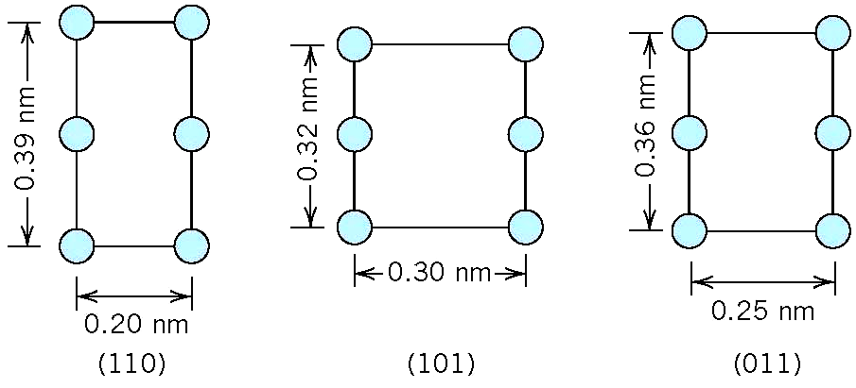
Below are shown three different crystallographic planes for a unit cell of some hypothetical metal. The circles represent atoms:
(a) To what crystal system does the unit cell belong?
(b) What would this crystal structure be called?
(c) If the density of this metal is 18.91 g/cm³,
determine its atomic weight.

Slide 60
6 lattice parameters
立方
六方
正方
斜方六面
斜方晶系
單斜
三斜

Slide 61
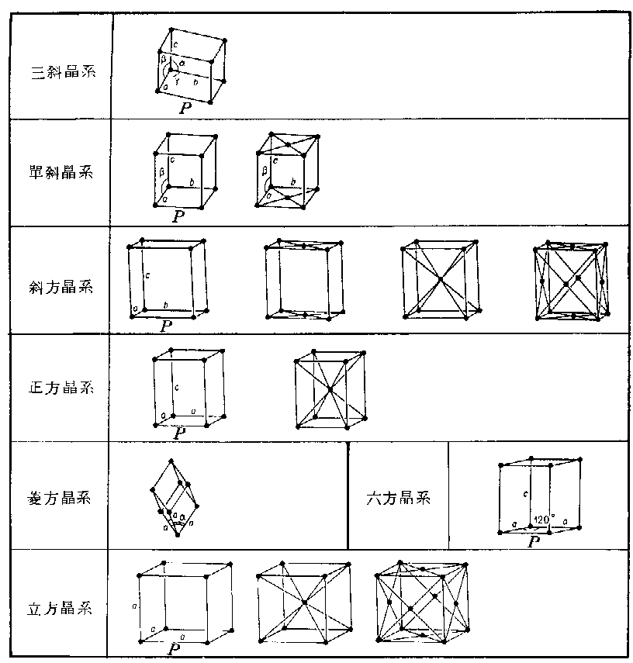
7 Crystal Systems
14 Bravais lattices
Triclinic
Monoclinic
Orthorhombic
Tetragonal
Hexagonal
Rhombohedral
Cubic

Slide 62
The metal rhodium has an FCC crystal structure. If the angle of diffraction for the (311) set of planes occurs at 36.12º (first order reflection) when monochromatic x-radiation having a wavelength of 0.0711 nm is used, compute (a) the interplanar spacing for this set of planes, and (b) the atomic radius for a rhodium atom.

Slide 63
Titanium has an HCP crystal structure and a density of
4.51 g/cm³.
What is the volume of its unit cell?
If the c/a ratio is 1.58, computer the values of c and a.

